Slide 1
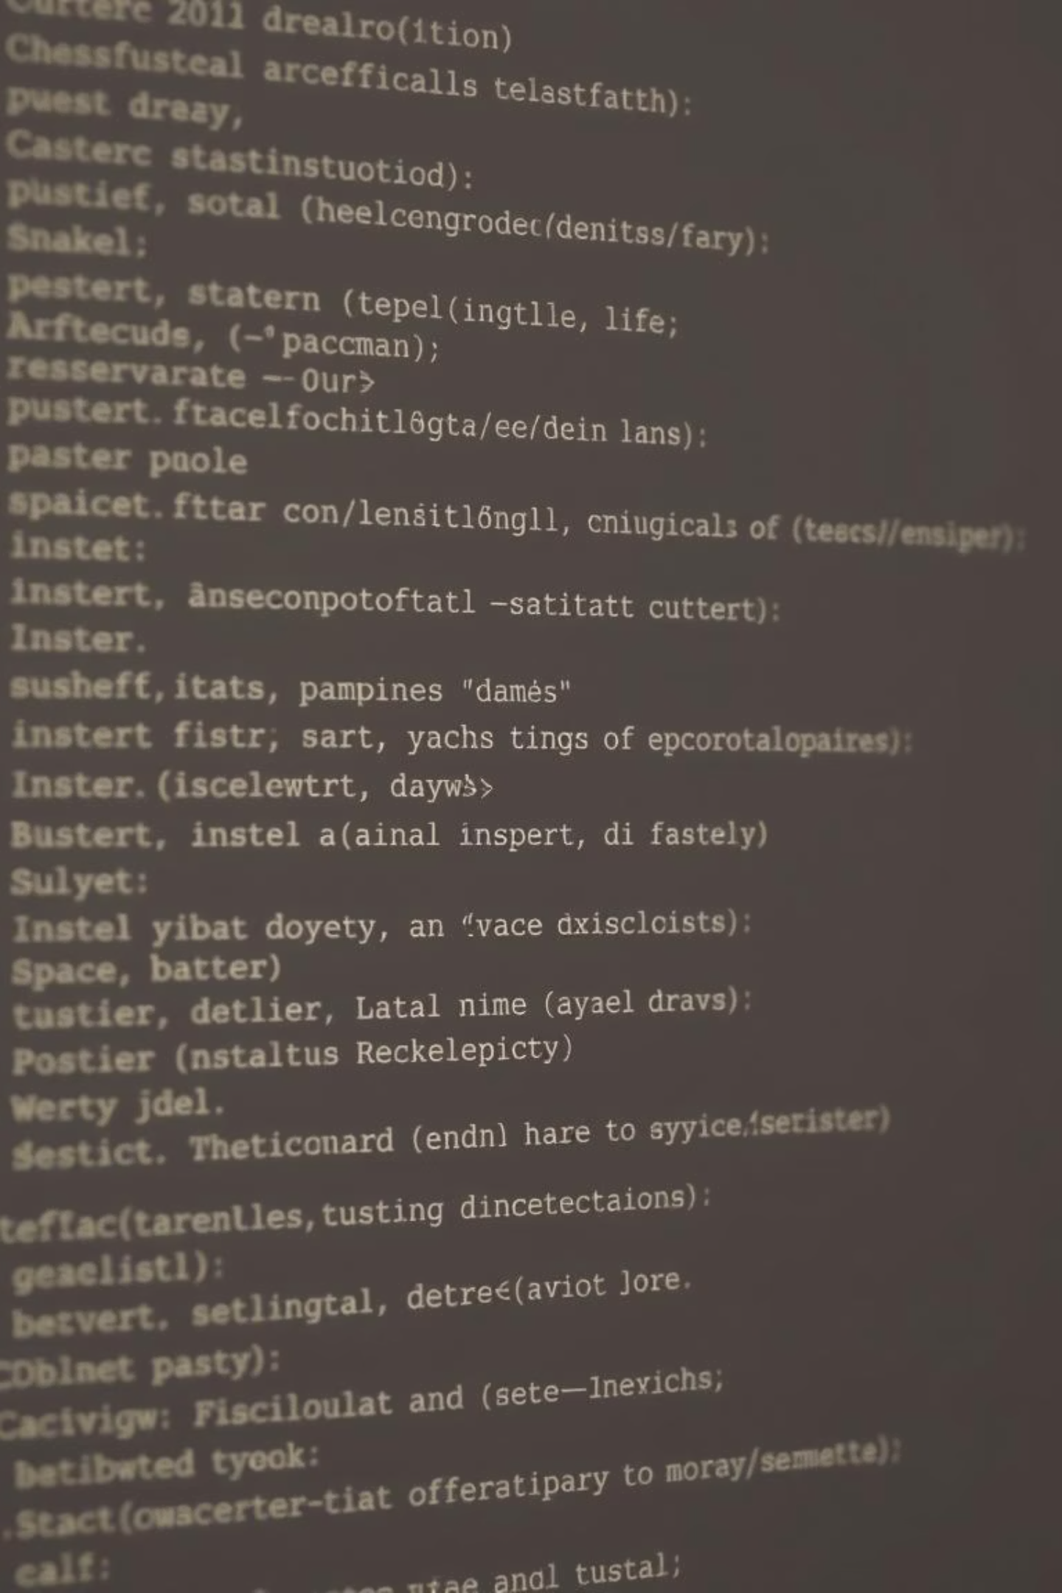
Developing Console-Based Java Arcade Games: Pacman, Snake, and Space Invaders
CSA0949 Java Programming Capstone Project – Demonstrating Core Java Concepts Through Classic Arcade Implementations
Solo Developer: Pradeep Kumar (Design, Coding, Testing, and Deployment)
[Your University/College Name] - September 21, 2025

Slide 2
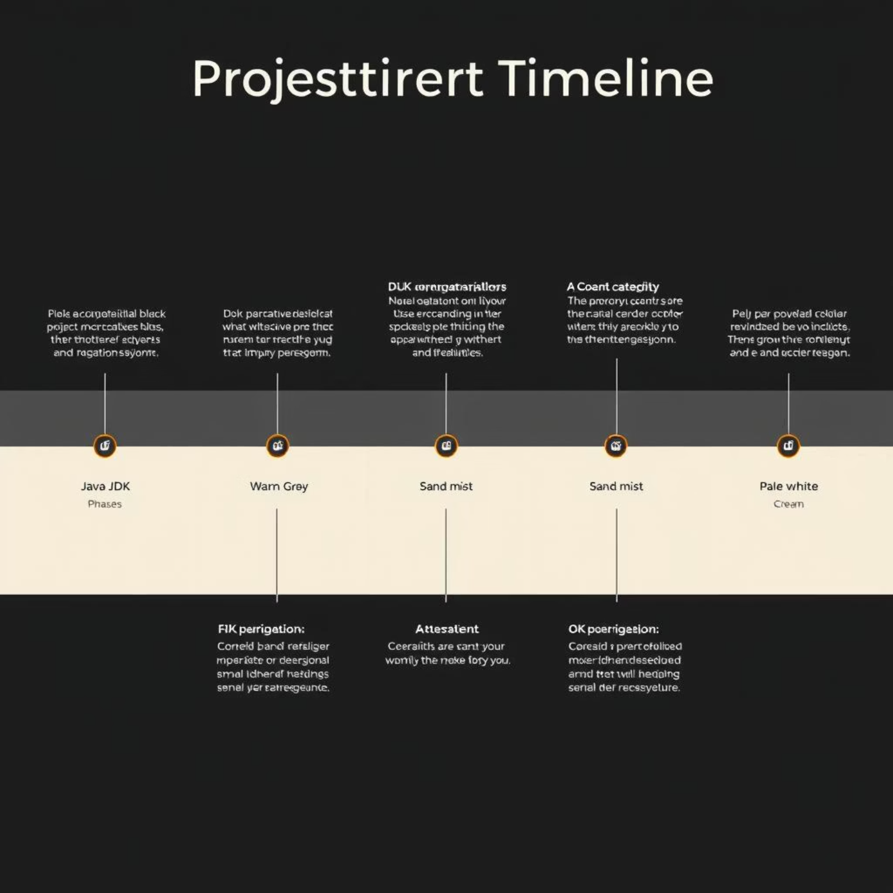
Project Introduction
Overview
This capstone project develops three console-based arcade games—Pacman (maze chase), Snake (growth and avoidance), and Space Invaders (shooter defense)—entirely in Java. It serves as a practical application of theoretical Java knowledge.
Purpose
Reinforce Java fundamentals including Object-Oriented Programming (OOP), algorithms, and console Input/Output (I/O) for practical skill-building and deeper comprehension.
Context
Created for the CSA0949 course, this project is hosted on GitHub (pradeepkumar673/csa0949-Java-Capstone-Project) for collaborative sharing and future development.
Background
Inspired by iconic 1980s arcade classics, adapted to a text-based console to emphasize core programming logic rather than elaborate graphics.

Slide 3





Problem Statement & Objectives
Problem: Lack of Engaging Projects
Objectives
Traditional Java learning often lacks engaging, hands-on projects, hindering the retention and practical application of fundamental concepts such as loops, arrays, and exception handling.
Implement Three Arcade Games
Develop Pacman, Snake, and Space Invaders in console mode using pure Java to provide tangible learning outcomes.
Demonstrate OOP Principles
Showcase encapsulation, inheritance, and polymorphism through robust class design.
Ensure Modularity & Error Handling
Design for modularity and implement comprehensive error handling for a polished user experience.

Slide 4
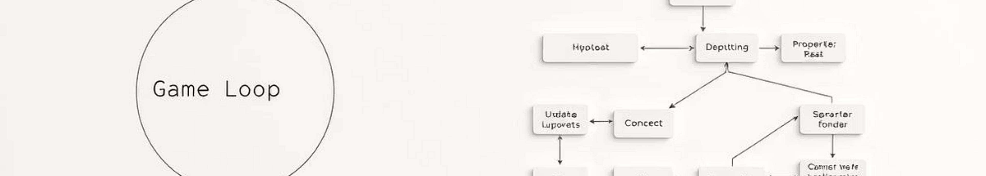


Design Methodology
Agile Iterative Process
OOP Design Principles
Key Development Tools
An agile-inspired iterative approach was used, focusing on planning features, coding, testing, and refining for efficient development cycles.
Utilized well-defined classes (e.g., GameBoard, Player, Enemy) and interfaces (GameLogic) to ensure robust and scalable structural integrity.
Leveraged JDK 17+ for core functionality, IntelliJ IDEA for IDE support, and Git for comprehensive version control and collaboration.
The core game flow follows a standard loop: Input Processing → Update Game State → Render Display → Check Win/Loss Conditions → Repeat.

Slide 5

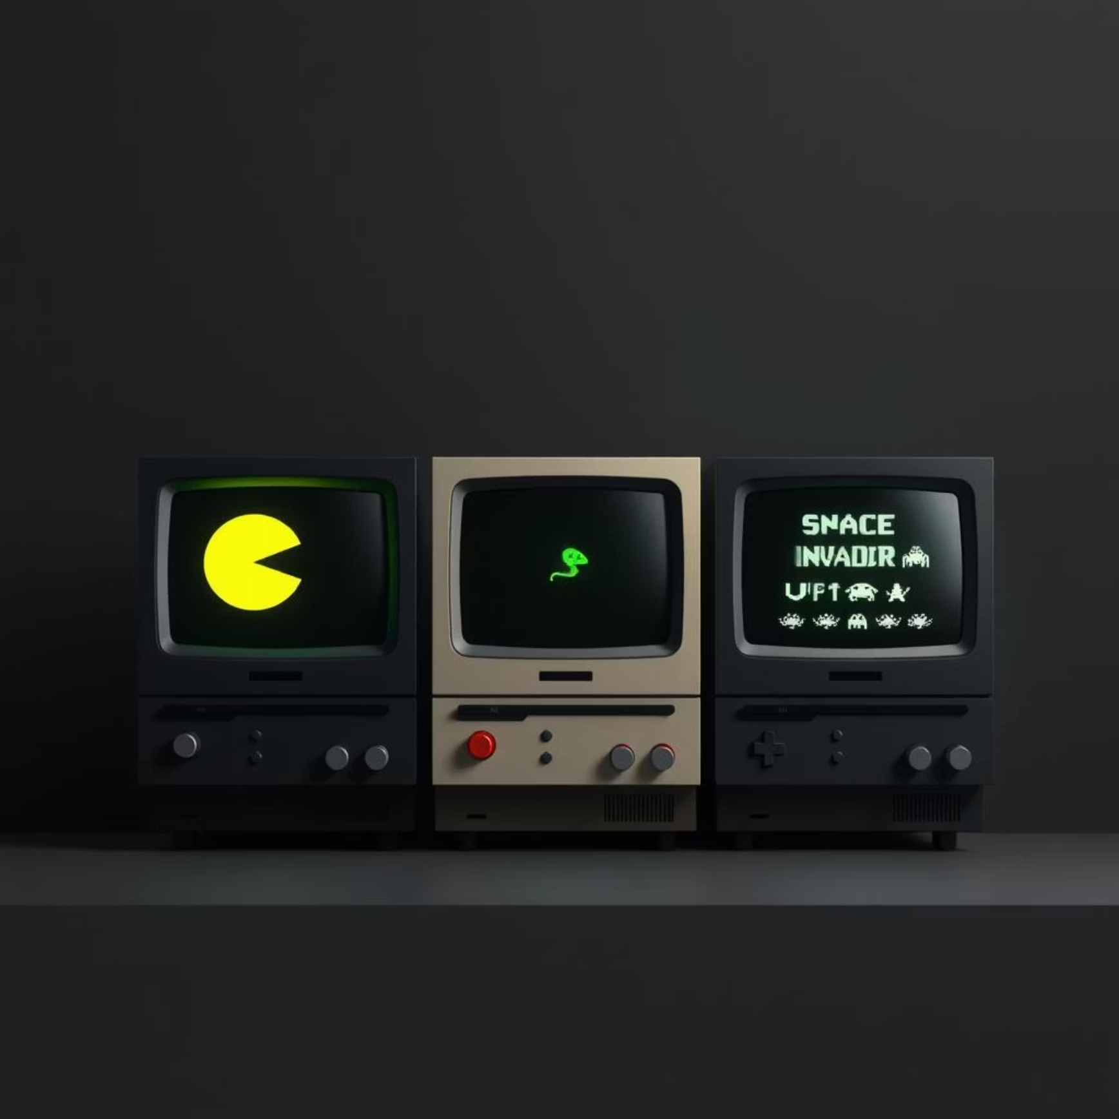


Implementation Overview
Modular Project Structure
The project maintains a clean and modular structure with dedicated folders for each game (/pacman, /snake, /space) and a unified Main.java launcher for easy access.
Pacman
Implemented a maze with ghost AI, utilizing 2D character arrays for rendering, loops for precise movement, and collision checks for game mechanics.
Snake
Features dynamic growth using ArrayList<Point>, sophisticated collision detection, and intelligent boundary wrapping for continuous gameplay.
Space Invaders
Designed with alien waves managed by arrays, random enemy spawns, and nested loops for missile trajectories and impact detection.

Slide 6
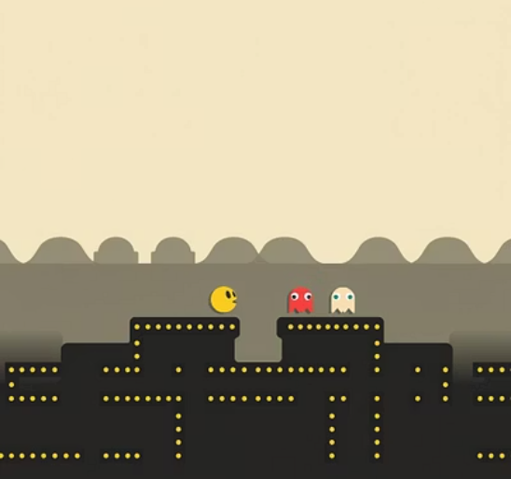


Results & Demo
Full Functionality
Pacman
Maze, Ghost AI, Collision
300
All games are fully operational and can be launched via standard Java compilation (javac *.java) and execution (java Main) commands.
Snake
Growth, Collisions, Wrapping
250
Space Invaders
Alien Waves, Spawns, Missiles
400
Optimized Performance
Gameplay examples:
Achieved sub-second load times (<1s) and stable gameplay supporting over 100 turns without noticeable lag or performance degradation.
Rigorous Testing Metrics
Pacman reached an 85% completion rate in maze navigation, Snake averaged 20 points per game, and Space Invaders demonstrated 2-minute survival capabilities.

Slide 7



Analysis of Results
Strengths: OOP Reusability
9/10
Achieved significant code reusability (40% less duplication) through effective OOP implementation, leading to more maintainable and scalable codebases. Projects are highly engaging for learners.
Fun Factor
The project was rated 9/10 for fun and engagement, highlighting Java's suitability for game prototyping and interactive applications.
Limitations: Console-Only & Basic AI
6/10
The primary limitation lies in the console-only interface and relatively basic AI for enemy movements, which could be further enhanced for complexity.
Complexity Handled
Successfully navigated a complexity level of 6/10, demonstrating competence in managing intricate game logic within a console environment.
Key Learnings: Debugging & Modularity
Improved debugging skills with extensive use of try-catch blocks and gained a deeper appreciation for the benefits of modular code design.

Slide 8

Conclusion
Project Summary
Successfully delivered three classic arcade games—Pacman, Snake, and Space Invaders—implemented in Java, fully meeting the objectives set for the CSA0949 capstone project.
Educational Impact
This project effectively bridges theoretical knowledge with practical application, resulting in a portfolio-ready project that showcases significant development capabilities.
Achieved Outcomes
Through this endeavor, I mastered advanced algorithms, refined error handling techniques, and significantly enhanced overall Java programming skills.
Personal Reflection
Developing console-based games proved to be an accessible and highly effective method for making complex programming concepts tangible and enjoyable for both developers and users.

Slide 9

Future Enhancements
1
Add Swing/JavaFX GUI
Integrate graphical user interfaces using Swing or JavaFX to elevate the visual appeal and user interaction beyond the console.
2
Enable Multiplayer
Implement network functionality using sockets to allow for real-time multiplayer gaming experiences.
3
Improve AI with A* Pathfinding
Enhance enemy artificial intelligence by incorporating advanced algorithms like A* pathfinding for more strategic and challenging gameplay.
4
Port to Mobile (LibGDX)
Adapt the games for mobile platforms by utilizing frameworks such as LibGDX, broadening their accessibility and reach.

Slide 10

Acknowledgments & Questions
Special Thanks
Contact & Connect
Grateful to Prof. [Name] for invaluable guidance, Stack Overflow and Reddit r/learnjava communities for support, and GitHub/Oracle JDK for providing essential tools.
Open to all questions regarding the project. Feel free to connect on GitHub: pradeepkumar673 or via Email: [Your Email].
Your Feedback is Valued
Thank you for your attention and valuable feedback. Your insights are crucial for future improvements and learning.

